Slide 1
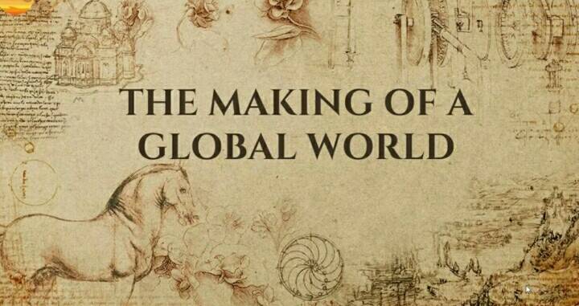

Slide 4
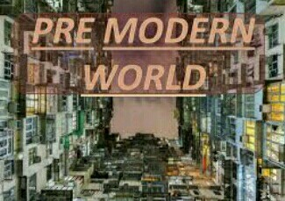

Slide 5
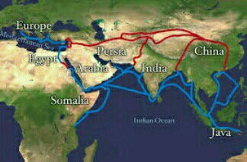

Slide 6
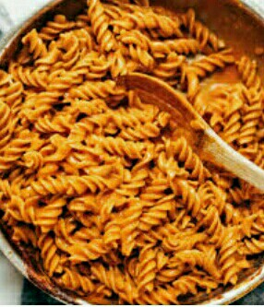

Slide 8
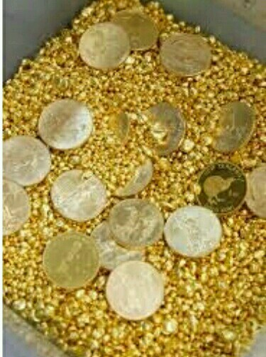
Conquest, Disease and Trade :
The pre-modern world shrank after European
sailors found a sea route to Asia and America
in the 16th century.
The Indian subcontinent was central to the trade,
but the entry of Europeans helped to expand
this trade towards Europe.
The Spanish and Portuguese were the first European
to conquer America in mid – 16 century.
Precious metal, silver, found in the mines and financed its
trade with Asia.
Legends spread about EL Dorado, the fabled city
of gold in South America.

Slide 9
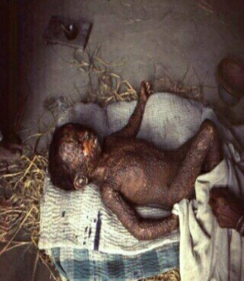
Affected CHILD – by small pox

Slide 10
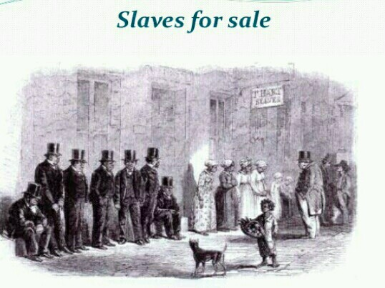
As a result, thousand od European moved to America and slaves
captured in Africa worked in plantation of cotton and sugar
for European market.
Europe emerged a the centre of world trade.

Slide 12
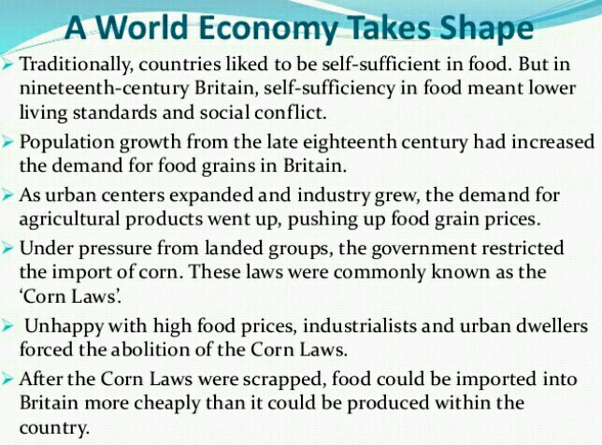

Slide 13
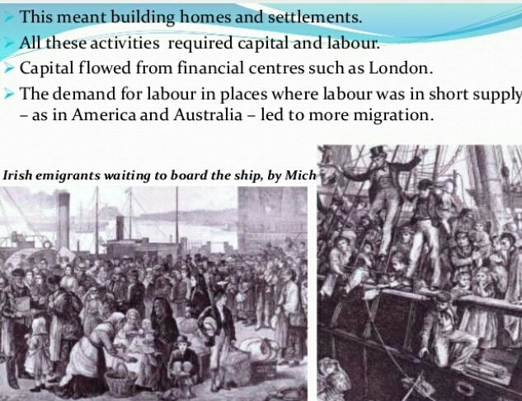

Slide 14
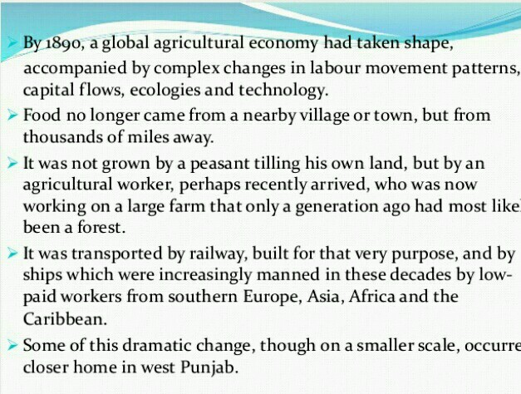
GLOBAL AGRICULTURAL ECONOMY

Slide 17
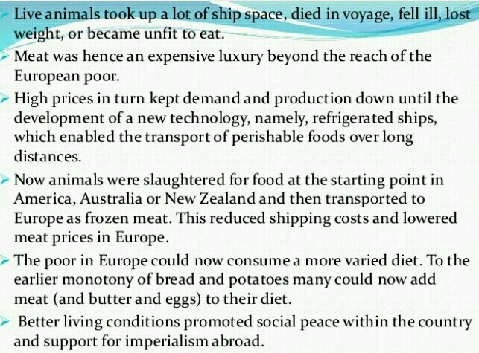
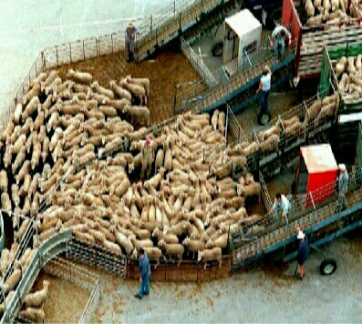

Slide 18
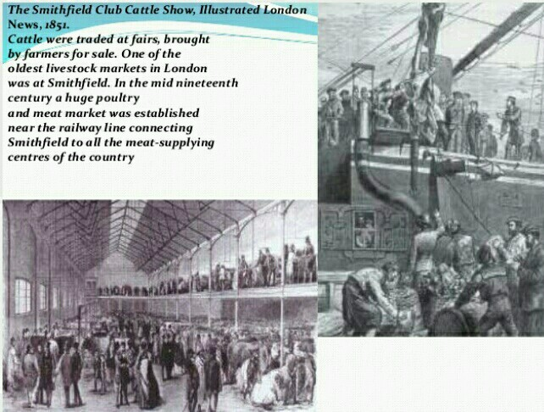

Slide 20
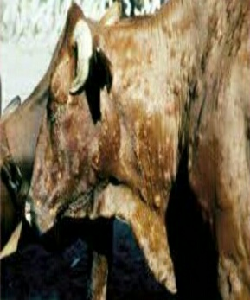

Slide 21
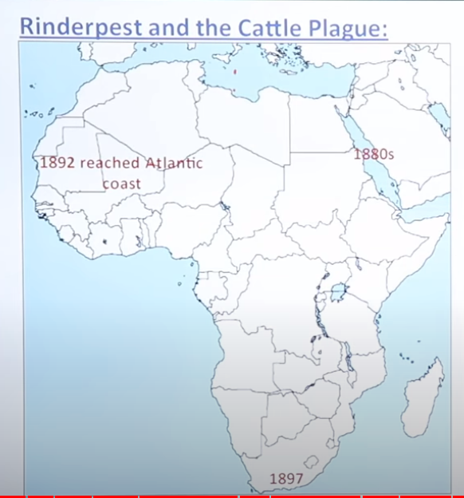

Slide 22
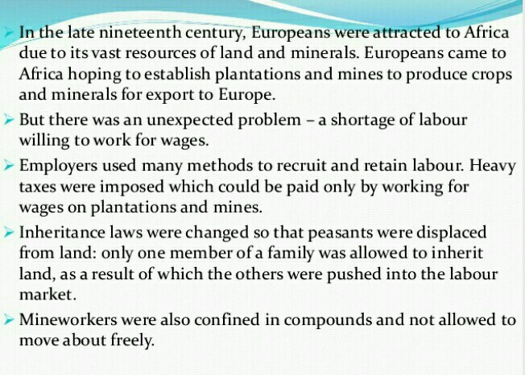

Slide 23
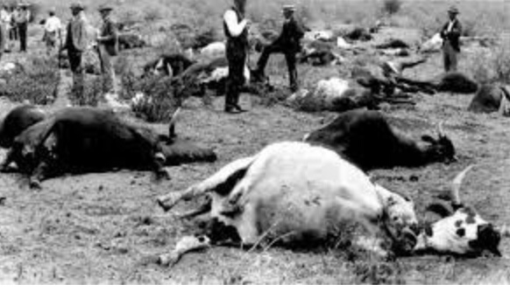

Slide 24
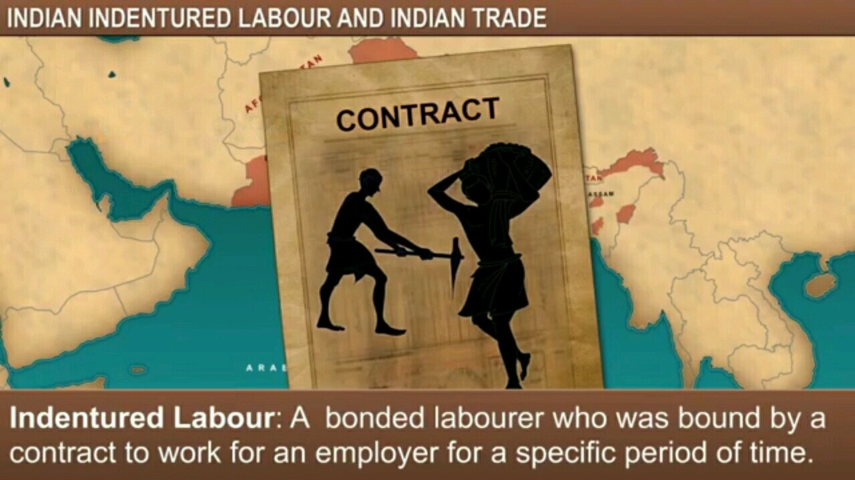

Slide 25
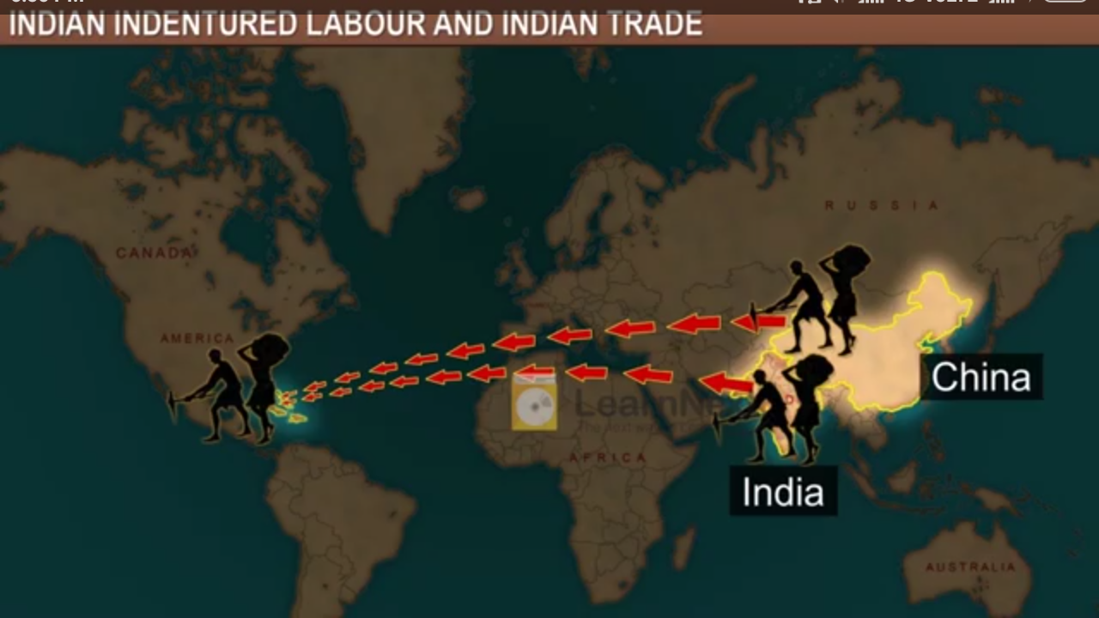
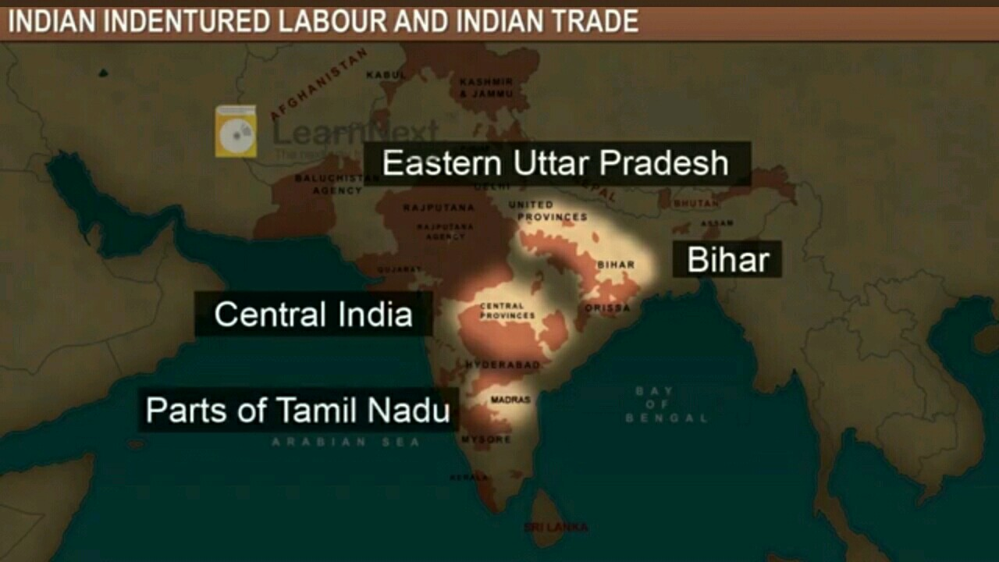

Slide 26
Rastafarianism – Jamaican reggae star
(Bob Marley)
Chutney music

Slide 32
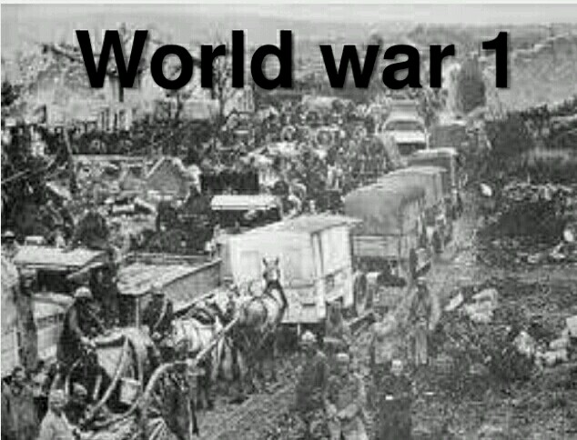
THE INTER-WAR ECONOMY

Slide 34
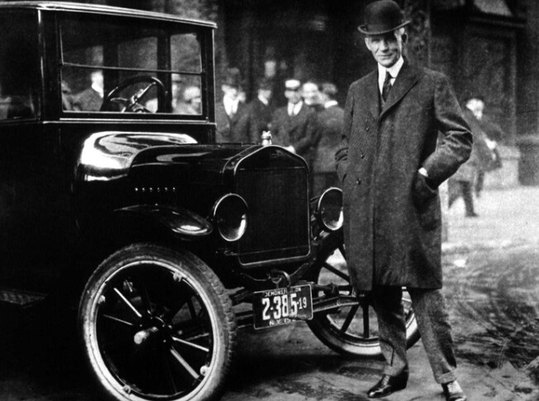

Slide 35
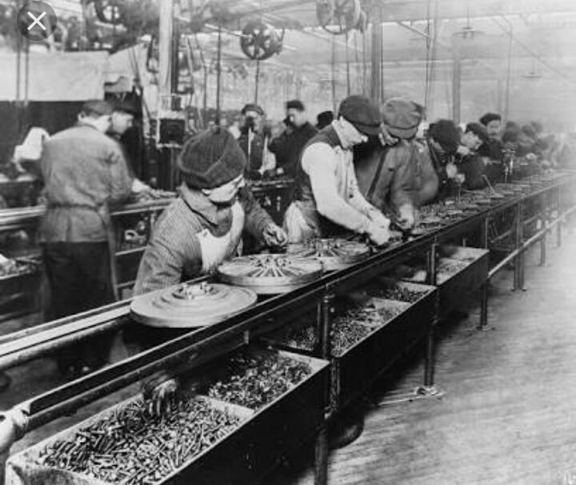
ASSEMBLY LINE – CONVEYOR BELT
The assembly line forced workers to repeat a single task
mechanically and continuously – such as fitting a particular
part to the car – at a pace dictated by the conveyor belt.

Slide 36
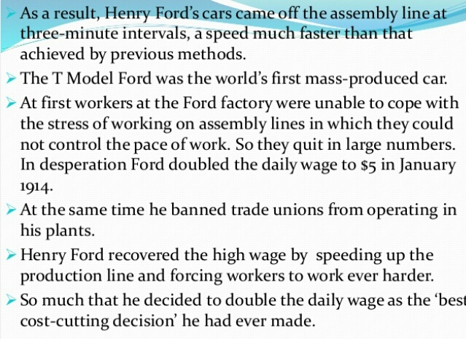
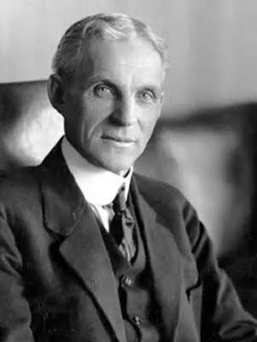
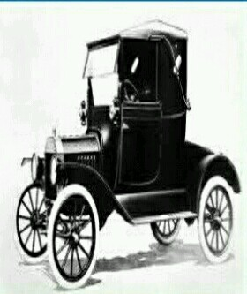

Slide 39
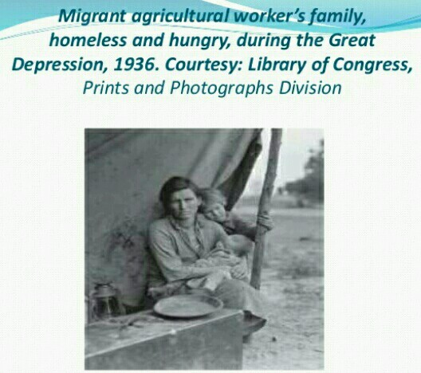

Slide 42
US AND THE GREAT DEPRESSION

Slide 43
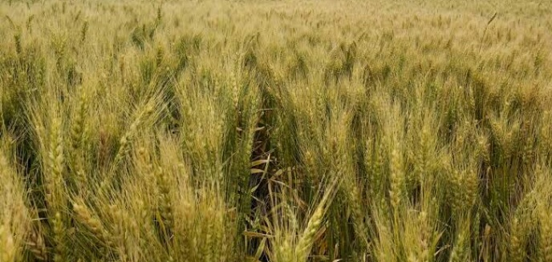

Slide 44
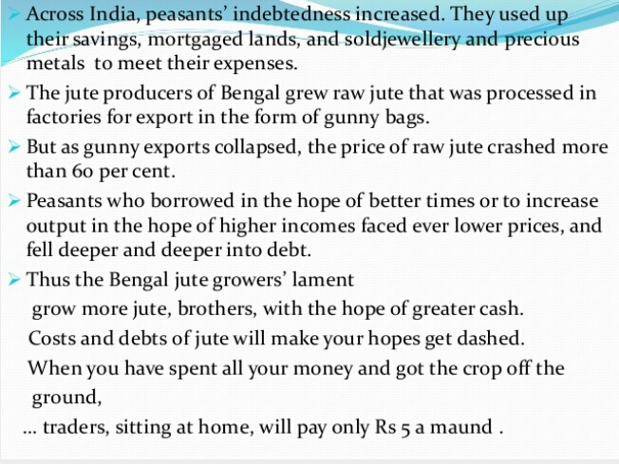
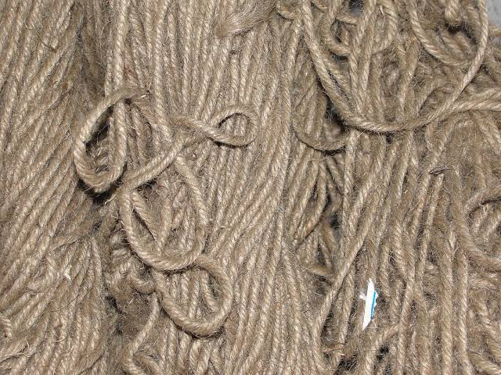

Slide 45
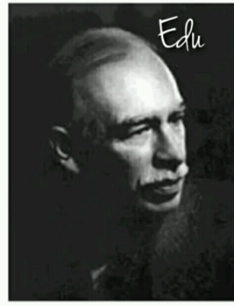
Economist
John Maynard Keynes

Slide 46
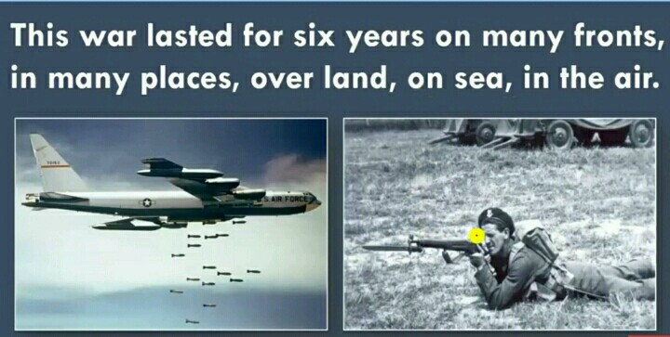
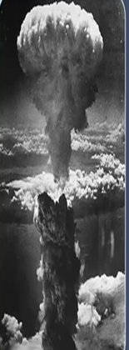
REBUILDING A WORLD ECONOMY : The Post-War Era
Vast parts of
Europe and Asia
were devasted and
several cities were
destroyed.

Slide 47
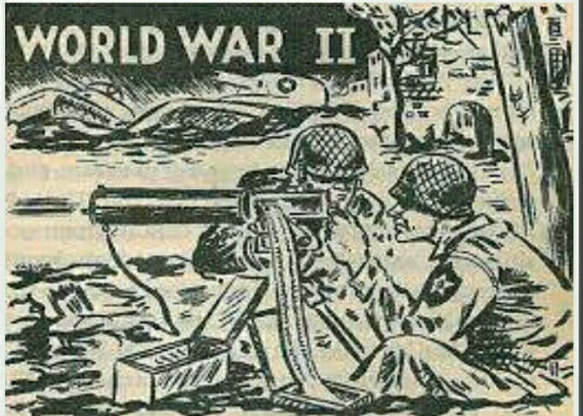

Slide 48
Post-War Reconstruction
Vast parts of Europe and Asia were devasted
and several cities were destroyed. Reconstruction
was long and difficult task.
Two crucial influences shaped post-war
reconstruction:
The US emerged as the world’s dominant
political and economic power after the war.
Soviet Union became super power. It defeated
Nazi Germany. It transformed itself from an
agricultural country into a world power and as a
leader of the communist bloc, Soviet Union posed
a great threat to the capitalist economy

Slide 49
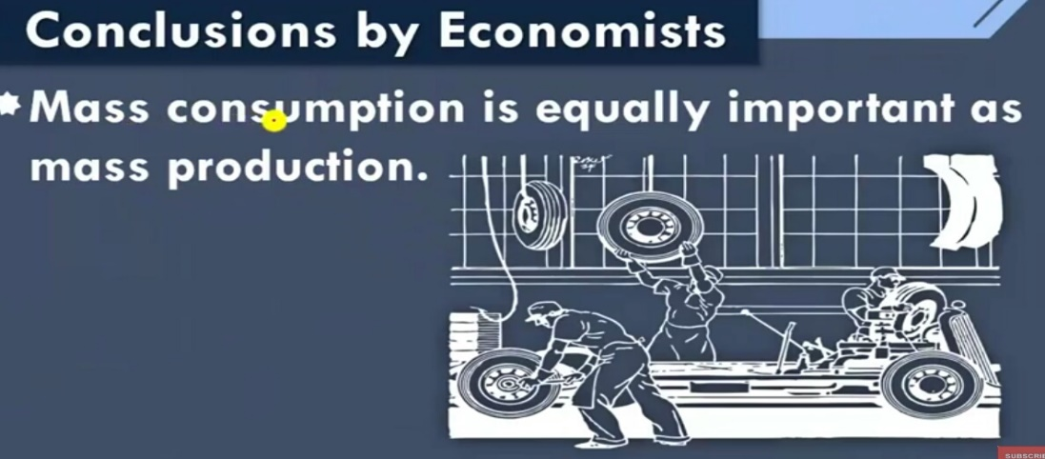
Post-War Settlement and the Bretton Woods Institutions
From inter-war economic experiences, two key
lessons are drawn by the economist and politicians:
The first lesson is an industrial society
based on mass production cannot be sustained
without mass consumption. Mass consumption
needed high and stable incomes. Stable incomes
require steady and full employment, for this
government should take necessary steps.
The second lesson related to a country’s
economic links with other countries. The goal of
full employment could only be achieved if
governments had power to control
flows of goods, capital and labour.

Slide 50
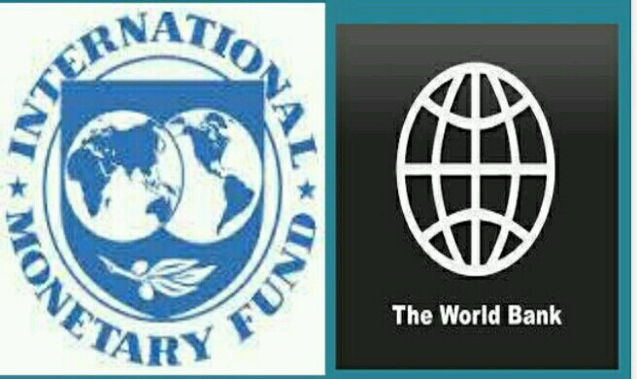

Slide 54
CONDITION OF DEVELOPING NATIONS

